Slide 1
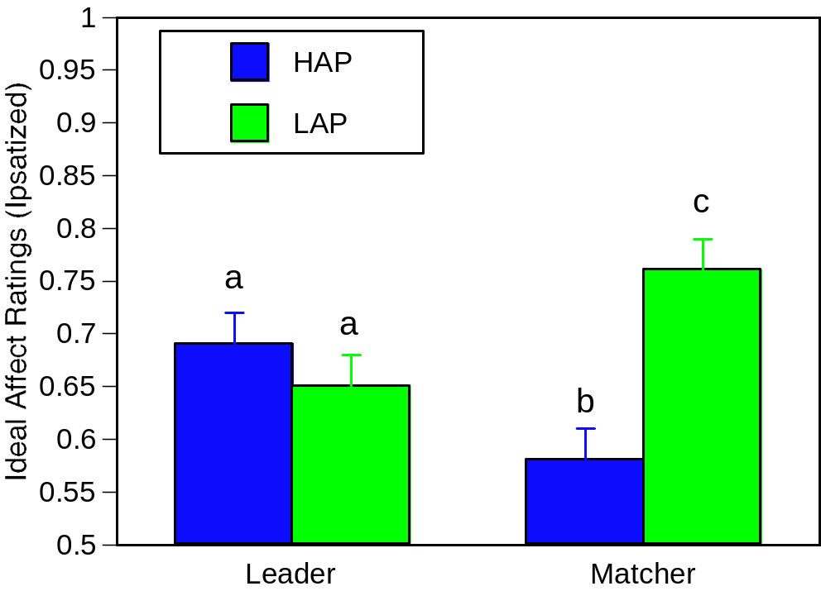
Across Groups, Leaders Value HAP More and LAP Less Than Matchers
Role X Affect Type: F(1,47) = 6.47, p <.05

Slide 2
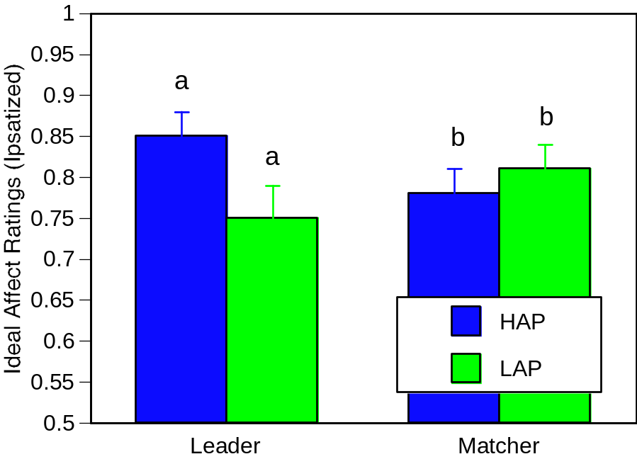
Across Trials and Groups, Leaders Value HAP More and LAP Less Than Matchers
Role X Affect Type: F(1,27) = 5.49, p <.05

Slide 3
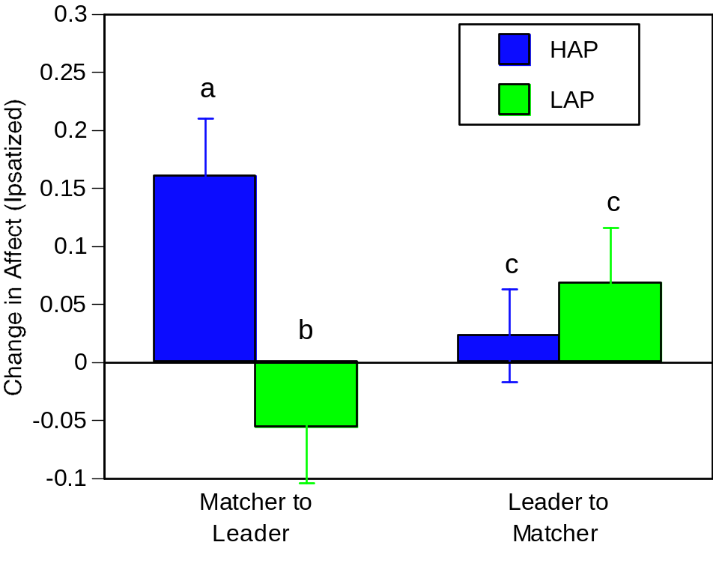
Across Groups, Changes in Roles Result in Changes in Ideal Affect
Role X Affect Type: F(1,27) = 5.49, p <.05

